Slide 1
Team Name: Team Members:
Date

Slide 2
Project Overview
Objective and model outputs:
Data set description:
Methodology:
The highest accuracy achieved:

Slide 3
Methodology
What kind of Neural Network layers do you use in your model and why?
How do you choose the parameters for the layers? Did you try different combination of parameters?
Did you try different optimizer, learning rate, batch number and epoch number? What do you conclude from your experiments?

Slide 4
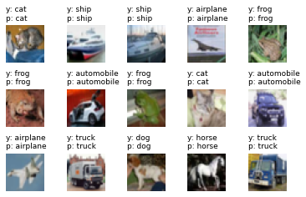
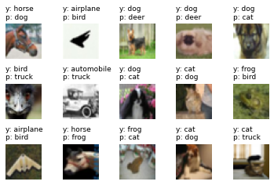
Examples of model outputs
Correct
Wrong
These are examples of model outputs (please remove)
Explanation of possible root causes for the inaccurate predictions?

Slide 5
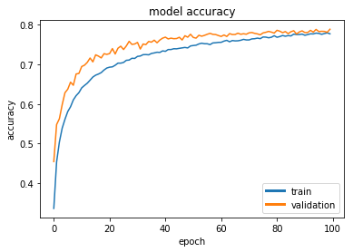
Conclusion and highest accuracy achieved
What is the highest accuracy achieved by your model on training and validation data sets?
Any overfitting?
What are the other possible methods to improve the accuracy?
This is an example of final results (please remove)

